Slide 1
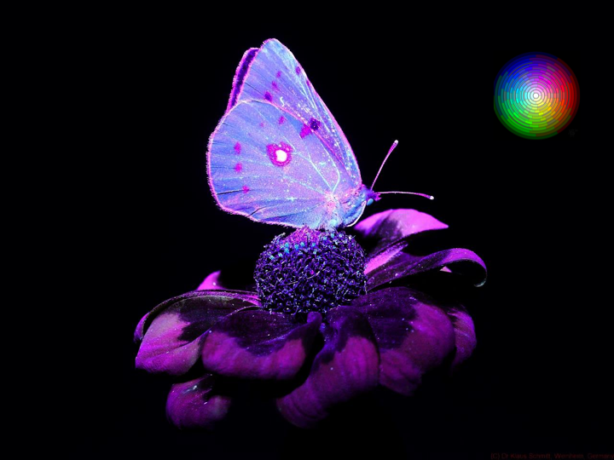

Introducing Students to
Transdisciplinary Educational and Research Experiences
Overcoming Bias To Solve Problems
Darryl P. Butt
Dept. of Materials Science and Engineering
Notes:
Intro: Who attended first three talks? 2/3? 1/3? Who’s here now—not everyone will pass the test…. (JN)
Intro: Mr. Kutchki (DB) Points-passion for teaching and learning, we learn best when we want to learn, sometimes more can be learned when we are open to tangents.
Mention his epic failures (1st talk in series)
Mention Innovation (2nd talk in series)
Mention Crossing the Lines (3rd talk in series)

Slide 2
Example
The VIP Concept: Science of Art
Preservation and Reverse Engineering of Cultural Heritage I:
Theme: The Science, History, and Psychology of Color in Art
Book: Color by V. Finley and Literature
Preservation and Reverse Engineering of Cultural Heritage II:
Theme: Archeometry—Methods of Analyzing Materials in Art and Culture
Book: Scientific Methods and Cultural Heritage by G. Artioli and Literature
Preservation and Reverse Engineering of Cultural Heritage III:
Theme: Case Studies in the Forgery, Preservation, and Interpretation of Art and Materials of Cultural Heritage
Book: Caveat Emptor by Ken Perenyl and Literature
Preservation and Reverse Engineering of Cultural Heritage IV:
Theme: Internship or Focused Undergraduate Research Experience
✓
✓
?
?
Notes:
Intro: Who attended first three talks? 2/3? 1/3? Who’s here now—not everyone will pass the test…. (JN)
Intro: Mr. Kutchki (DB) Points-passion for teaching and learning, we learn best when we want to learn, sometimes more can be learned when we are open to tangents.
Mention his epic failures (1st talk in series)
Mention Innovation (2nd talk in series)
Mention Crossing the Lines (3rd talk in series)

Slide 3
“Reverse Engineering”-Discovery Through Analysis of Structure, Function, Purpose, Operation, Provenance*, Provenience*…
*contrary to some dictionaries… Provenance ≠ Provenience

Slide 4
Surface Analysis
Biomimetics
Forensics
Provenience
Sustainability
Dissection
Chemical Analysis
Provenance
Microscopy
Preservation
Pathology
Materials Characterization
“Reverse Engineering”
Forgery
Critical Infrastructure
Product Development
Restoration
Anthropology
Petrography
Archeology
Artist Purpose
Archeometry
Geology
Cultural Heritage
History

Slide 5
The VIP (Transdisciplinary) Concept:
Discipline 1
Discipline 6
Discipline 2
Discipline 7
Discipline 3
Vertically Integrated Project/Research Problem
Discipline 4
Discipline 8
Discipline 5
Discipline 9…..
Notes:
Intro: Who attended first three talks? 2/3? 1/3? Who’s here now—not everyone will pass the test…. (JN)
Intro: Mr. Kutchki (DB) Points-passion for teaching and learning, we learn best when we want to learn, sometimes more can be learned when we are open to tangents.
Mention his epic failures (1st talk in series)
Mention Innovation (2nd talk in series)
Mention Crossing the Lines (3rd talk in series)

Slide 6
The VIP (Transdisciplinary) Concept:
Psychology
Visual Arts
Sociology
Chemistry
Material Science
Vertically Integrated Project/Research Problem
Philosophy
Public Policy
Art History
Art Conservation
Notes:
Intro: Who attended first three talks? 2/3? 1/3? Who’s here now—not everyone will pass the test…. (JN)
Intro: Mr. Kutchki (DB) Points-passion for teaching and learning, we learn best when we want to learn, sometimes more can be learned when we are open to tangents.
Mention his epic failures (1st talk in series)
Mention Innovation (2nd talk in series)
Mention Crossing the Lines (3rd talk in series)

Slide 7
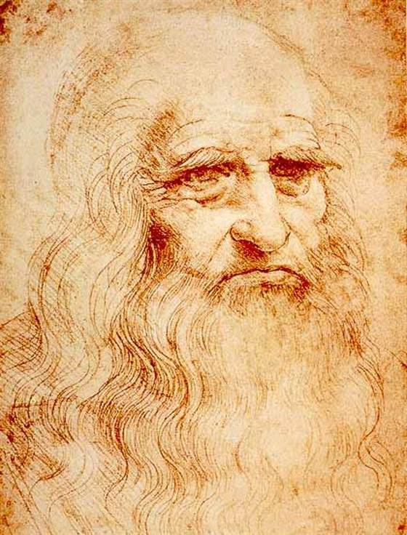
Leonardo Da Vinci: Savant
1452-1519
Personality/Experiences:
Son of a Slave
Son of a Notary
Perfectionist
Procrastinator
Uncompromising
Compulsive
Slow and Deliberate
No Fear of Failure
Disastrous Experimenter
No University Education
Student of Verrocchio
Employee of Lodovico
“Colorful” Dresser
Left Handed (Mancino)
Wrote Script in Reverse
Popular and Famous
Vegetarian
Devout Christian
Anti-Clergy
Humorist
Prankster
Master of Yogi-isms
Passionate, Life-Long Learner
Scholarship/Occupations:
Artist
Painter
Colorist
Sculpture
Metal Smith
Inventor
Alchemist
Botanist
Pathologist
Mathematician
Materials Scientist
Mechanical Scientist
Military Engineer
Military Architect
Hydrodynamic Engineer
Military Spy
Mountaineer
Set Designer
Event Planner
Writer
Musician
Red Pastel Portrait by Da Vinci, ~149X?, speculated to be a self-portrait.
Quote: “Men of Genius Sometimes Accomplish Most When They Work the Least…”
-Da Vinci to his employer, Lodovico, ref.: G. Vasari, et al., Lives of Artists, pp 262-263.
Notes:
Intro: Who attended first three talks? 2/3? 1/3? Who’s here now—not everyone will pass the test…. (JN)
Intro: Mr. Kutchki (DB) Points-passion for teaching and learning, we learn best when we want to learn, sometimes more can be learned when we are open to tangents.
Mention his epic failures (1st talk in series)
Mention Innovation (2nd talk in series)
Mention Crossing the Lines (3rd talk in series)

Slide 8
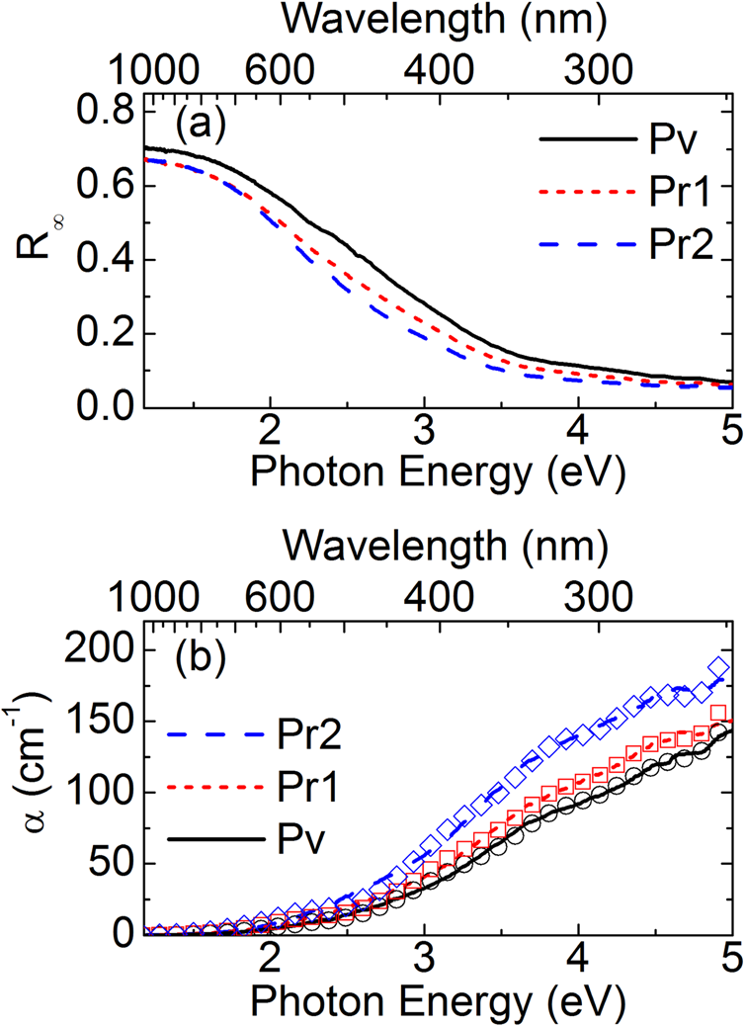
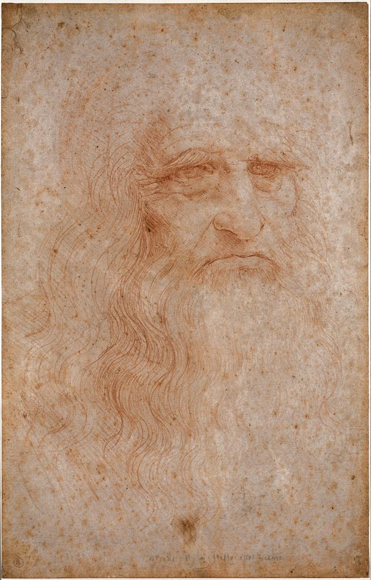
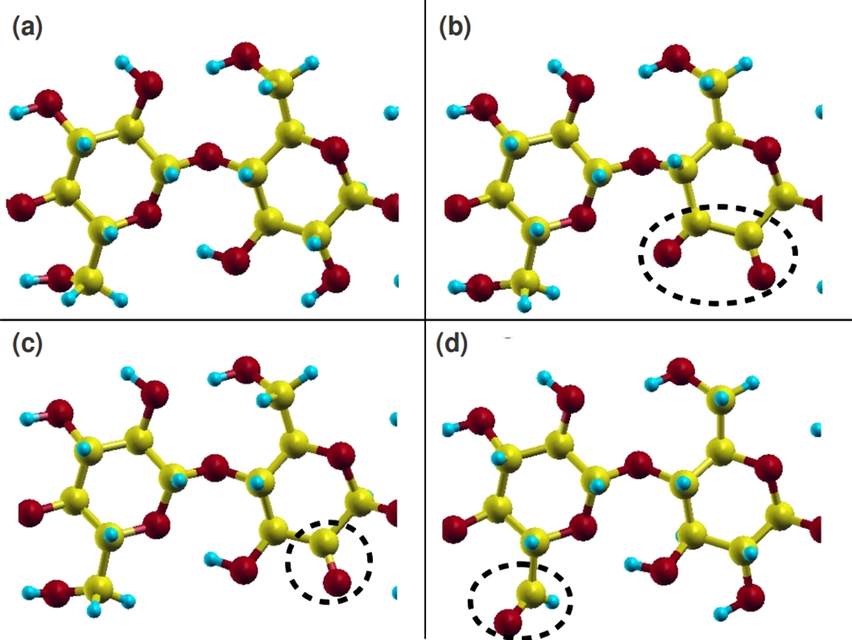
“Reverse Engineering” the Effects of “Entropy”
Post World War II Image
Diffuse Absolute Reflectance
Spectroscopy
Severe “foxing”
Embrittlement
Oxidation (yellowing)
of the parchment
Red Chalk
The inscription,
“Leonardus Vincius”
has vanished
Oxidized Groups
Of Cellulose
TD DFT Simulations
Image Source: ARTstor
Currently stored at 22°C, 55% RH, behind security
cameras and light absorbing glass.
Ref.: A. Mosca Conte, O. Pulci, M. C. Misiti, J. Lojewska, L. Teodonio, C. Violante, and M. Missori, Appl. Phys. Lett., 104, 2241010 (2014).
Notes:
What the image looks like now… perhaps symbolic that this image of Leonardo is fading away.

Slide 9
Fill in the Blank*
Proof of __________ is
Less Like a Mathematical Proof
Than it is Like a Proof in a
Court of Law
*Provenance, Provenience, a Theory, a Hypothesis, a Mechanism, a Scientific Concept…

Slide 10
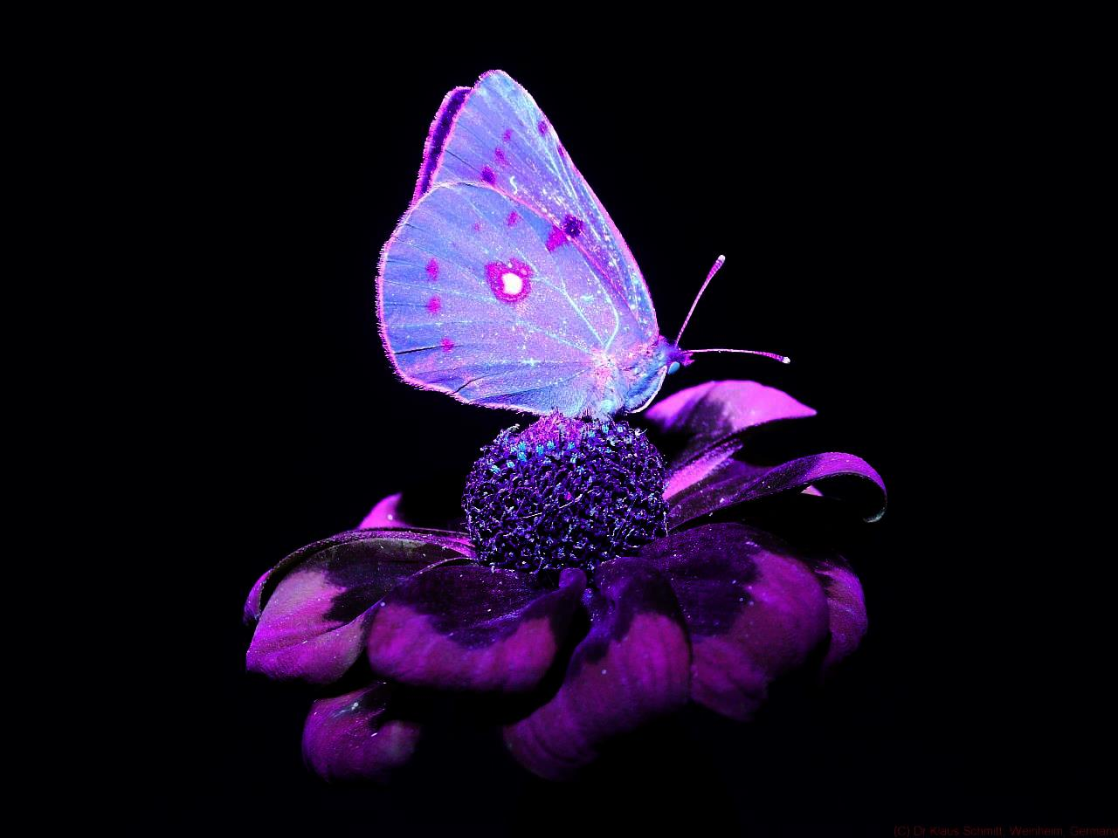
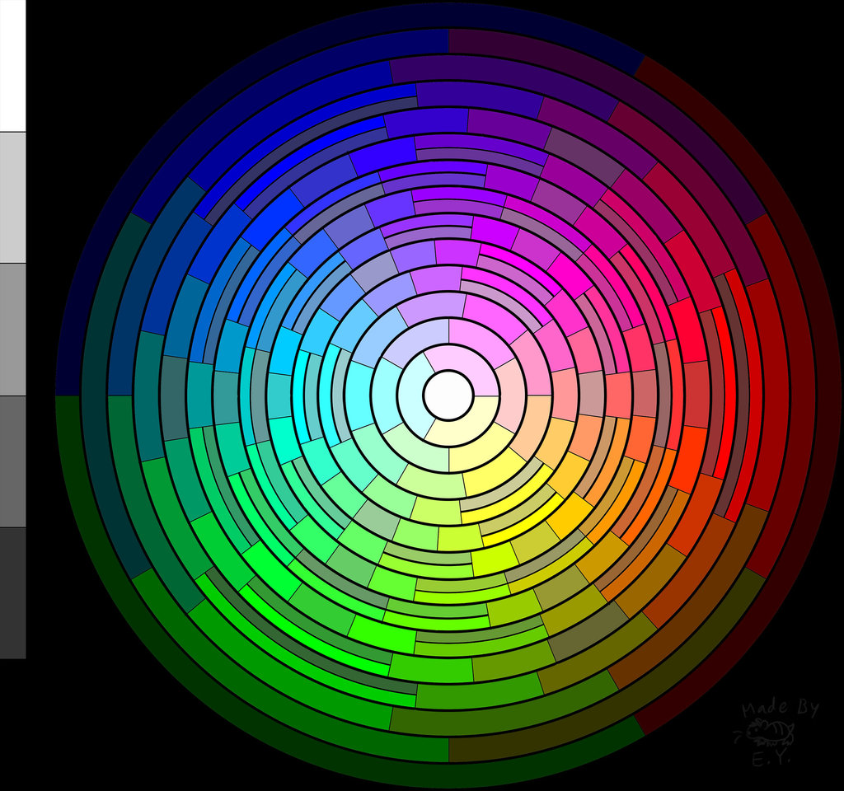
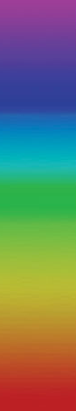
The Color Purple
400 nm
700 nm
Notes:
Here we can talk about the fact that butterflies see the color purple well. They see well from yellow into the UV range.
If you shine UV light on a butterfly that looks pure white to our eyes, the light reveals the invisible.
Hence, there is more to the butterfly than meets the eye…
We use light (electromagnetic radiation) to reveal features invisible to us…we shine “energy” on or through materials and “watch” how it responds…
Its not what we don’t know…. Its what we don’t know we don’t we don’t know
Purple is the last color on the spectrum (ROYGBIV)—400 nm wavelength.
It is the color of royalty. It has also been considered the color of death—the end of the known, the beginning of the unknown?

Slide 11
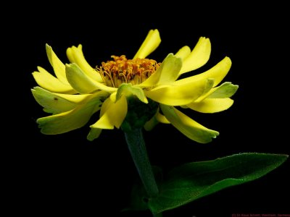
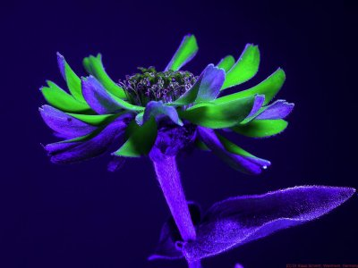
Notes:
Perhaps this is what a flower looks like to a butterfly.

Slide 12
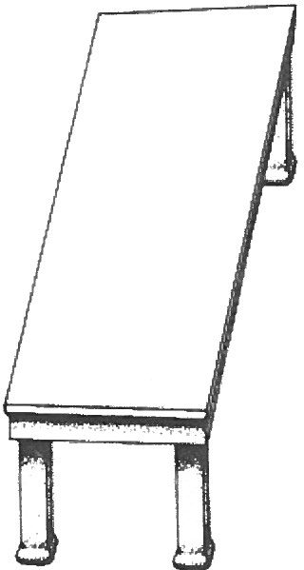
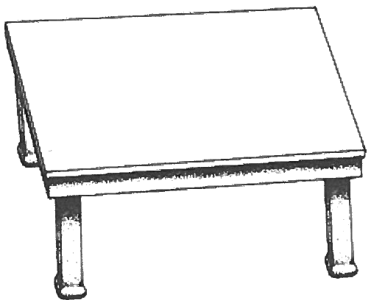
Which is longer? Which is wider?
“The greatest deception men suffer is from their own opinions.”—The Notebooks of
Leonardo Da Vinci.

Slide 13
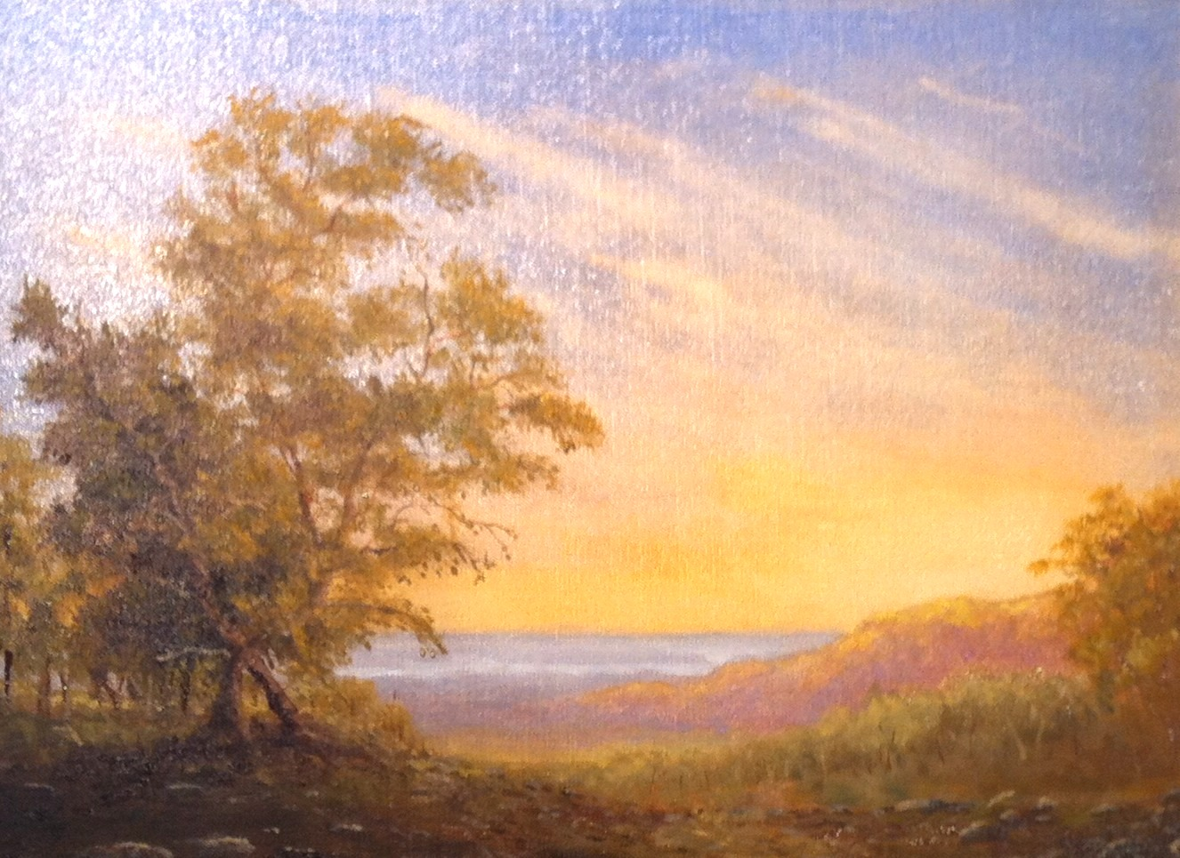
Construction of a Painting
Oil on Linen, in the style of the Hudson River School, D. P. Butt, 2012.

Slide 14
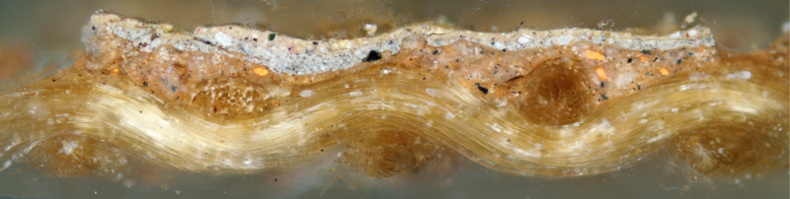
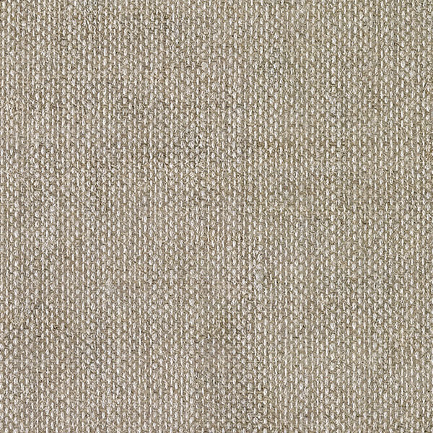
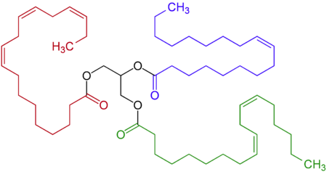
Painting Cross Section
Belgian Linen, Oil Primed
#66 Median Weave on Kiln Dried, Laminated Baltic Birch (1/8x12x16”)
Solvent: Gamsol, a mixture of aromatic hydrocarbons
Materials and Limited Palette
Pigments:
0.5-5 μm mineral derived powders or organics
Opaque White: Titanium Dioxide (Rutile) or TiO₂ (n = 2.72)
Cool and Warm Blues:
Complex Silicate of Sodium and Aluminum with Sulfur or Na₈Al₆Si₆O₂₄S_{4-x}
Iron Oxide Mix of FeO and Fe₂O₃
Cool and Warm Reds:
1,2-Dihydroxyantraquinone or C₁₄H₈O₄
Iron Oxides including FeO and Fe₂O₃-H₂O
Cool and Warm Yellows:
Mix of Zinc Oxide, Cadmium Zinc Sulfide, and Iron Oxide or ZnO, CdZnS, and Fe₂O₃-H₂O
Hydrated Iron(III) Oxide or Fe₂O₃-H₂O
Azomethine or C₁₆H₁₉N₅O₆
Primary Binder:
Viscosity = 5 cPoise
Mixture of
Vegetable Oil (Triester derived from linoleic and oleic acids)
Siccatives (lipophilic carboxylic and naphthenic acids)
Dark
Light
Warm
Cool
Warm
~12 Layers of Glaze
Oil on Linen, in the style of the Hudson River School, D. P. Butt, 2012.
“The surface of any opaque body is affected by the color of surrounding objects… colors are most intense when surrounded by their contrasts…”—from the notebooks of Leonardo Da Vinci.
Notes:
e.g.,

Slide 15
Reverse Engineer This
Notes:
What would it take to reverse engineer this painting? What questions would you ask?
What are the materials?
How was it painted?
How many layers are in the painting?
When was it painted?
Who painted it?
Why did they paint it?
When did they paint it?
What does it mean?
What methods would you use?
Restriction: You can’t damage or perhaps even touch the painting in any way.

Slide 16
(“Fayum”) Mummy Portraits and the Color Purple
Fusion of Egyptian religious rites,
Roman artistic style, and Greek cultural traditions*
*Ref. C. Cartwright and A. Middleton, Br. Mus. Tech. Res. Bull., 2, 59 (2008).
Notes:
Fusion of Egyptian religious rites,
Roman artistic style, and Greek cultural traditions*
Very little art, pre-1500s survives
These appeared on the art market ~1880-1920… then supply dried up (no pun intended)
Ours was procured by Henry Walters in 1909 (a railroad tycoon)
Part

Slide 17
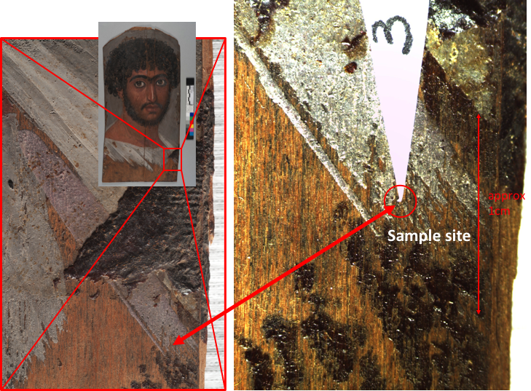
Mummy Sampling for the APPEAR Project
APPEAR=Ancient Panel Paintings: Examination Analysis and Research

Slide 18
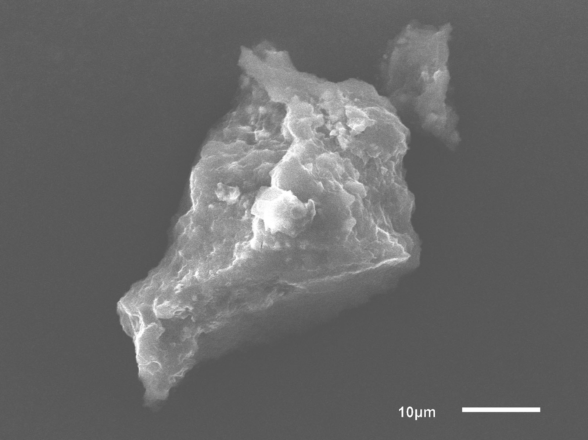
Pigment particle
E
LEAP samples
C
A
TEM sample #1
TEM sample #2
Pigment particle under SEM. Locations of TEM samples are in red and those of LEAP samples are in blue.

Slide 19
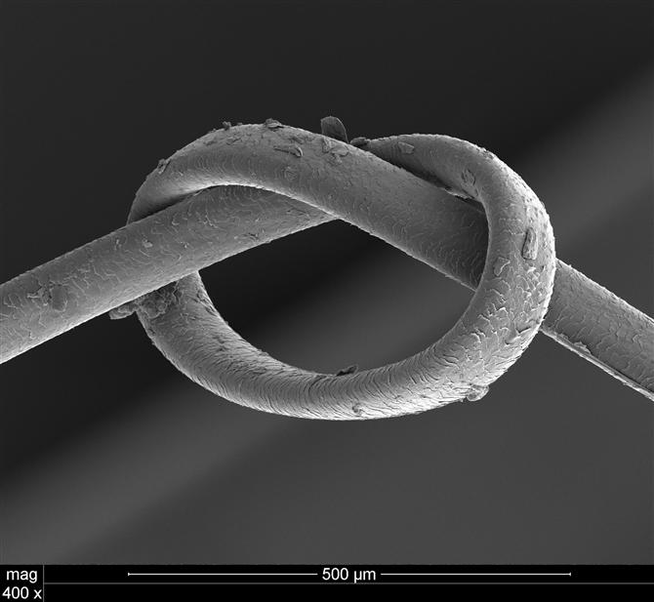
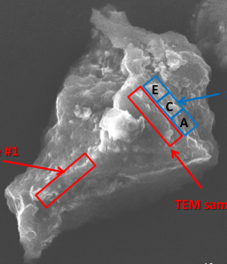
Particle

Slide 20
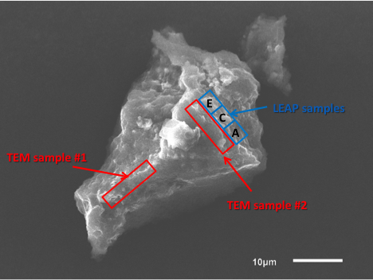
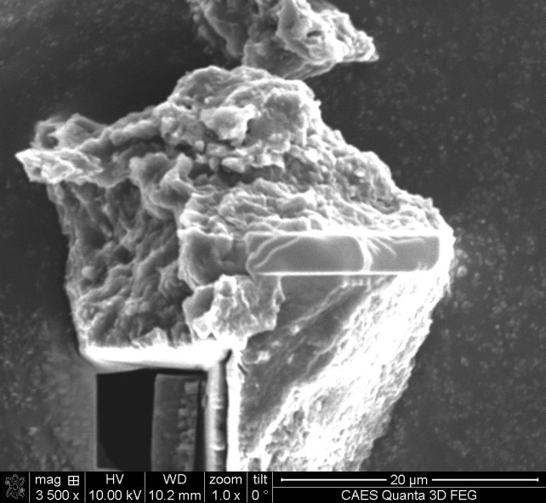
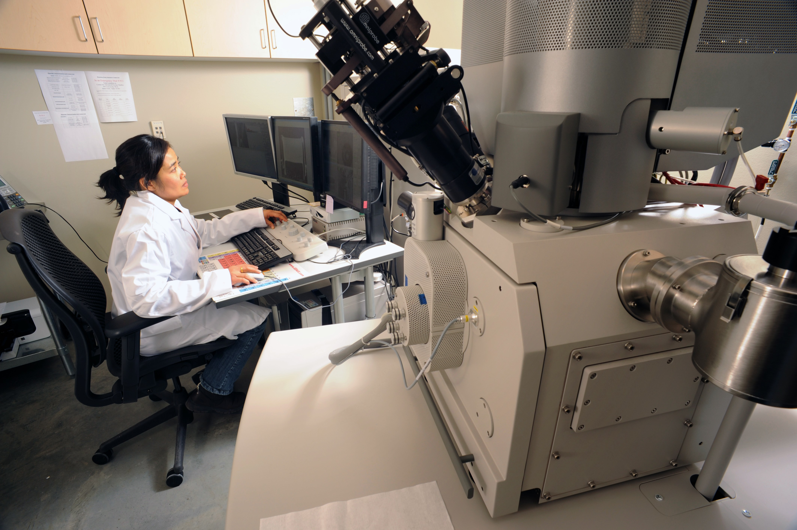
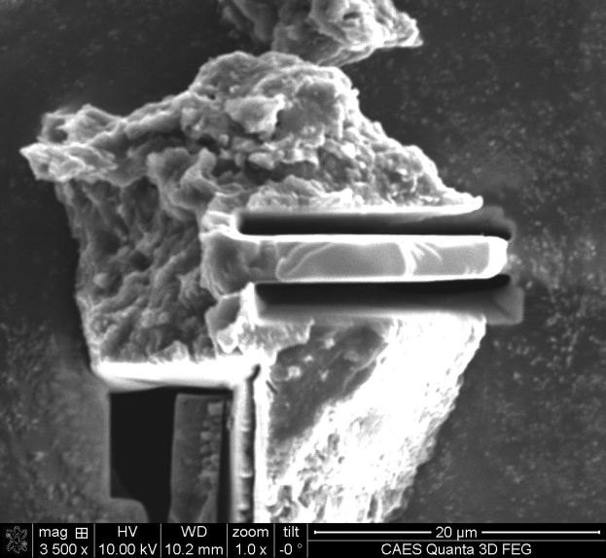
Partially Machined Pigment Particle
Quanta 3D Dual Beam FIB at CAES

Slide 21
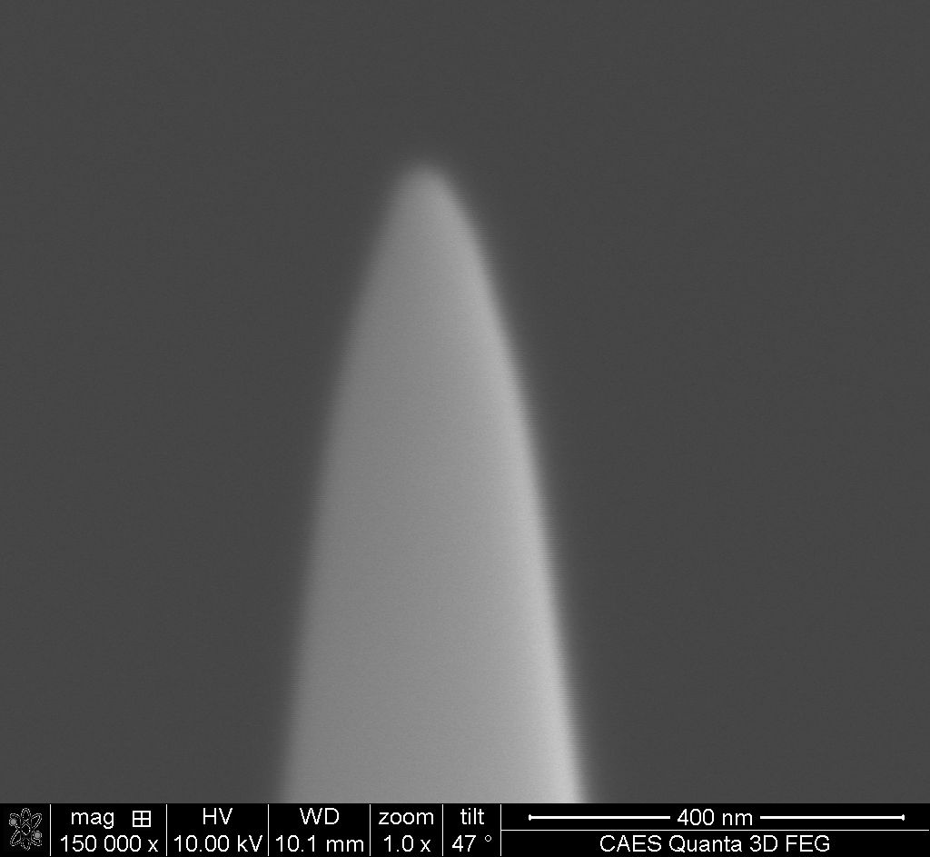
Machined Sample x10
Particle

Slide 22
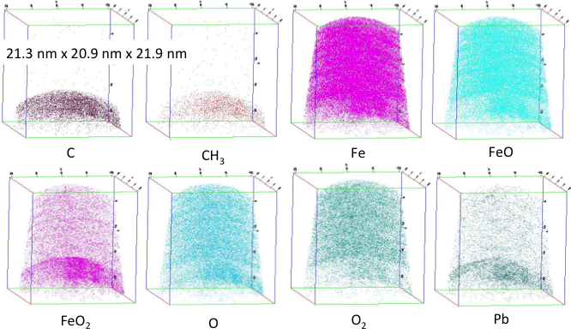
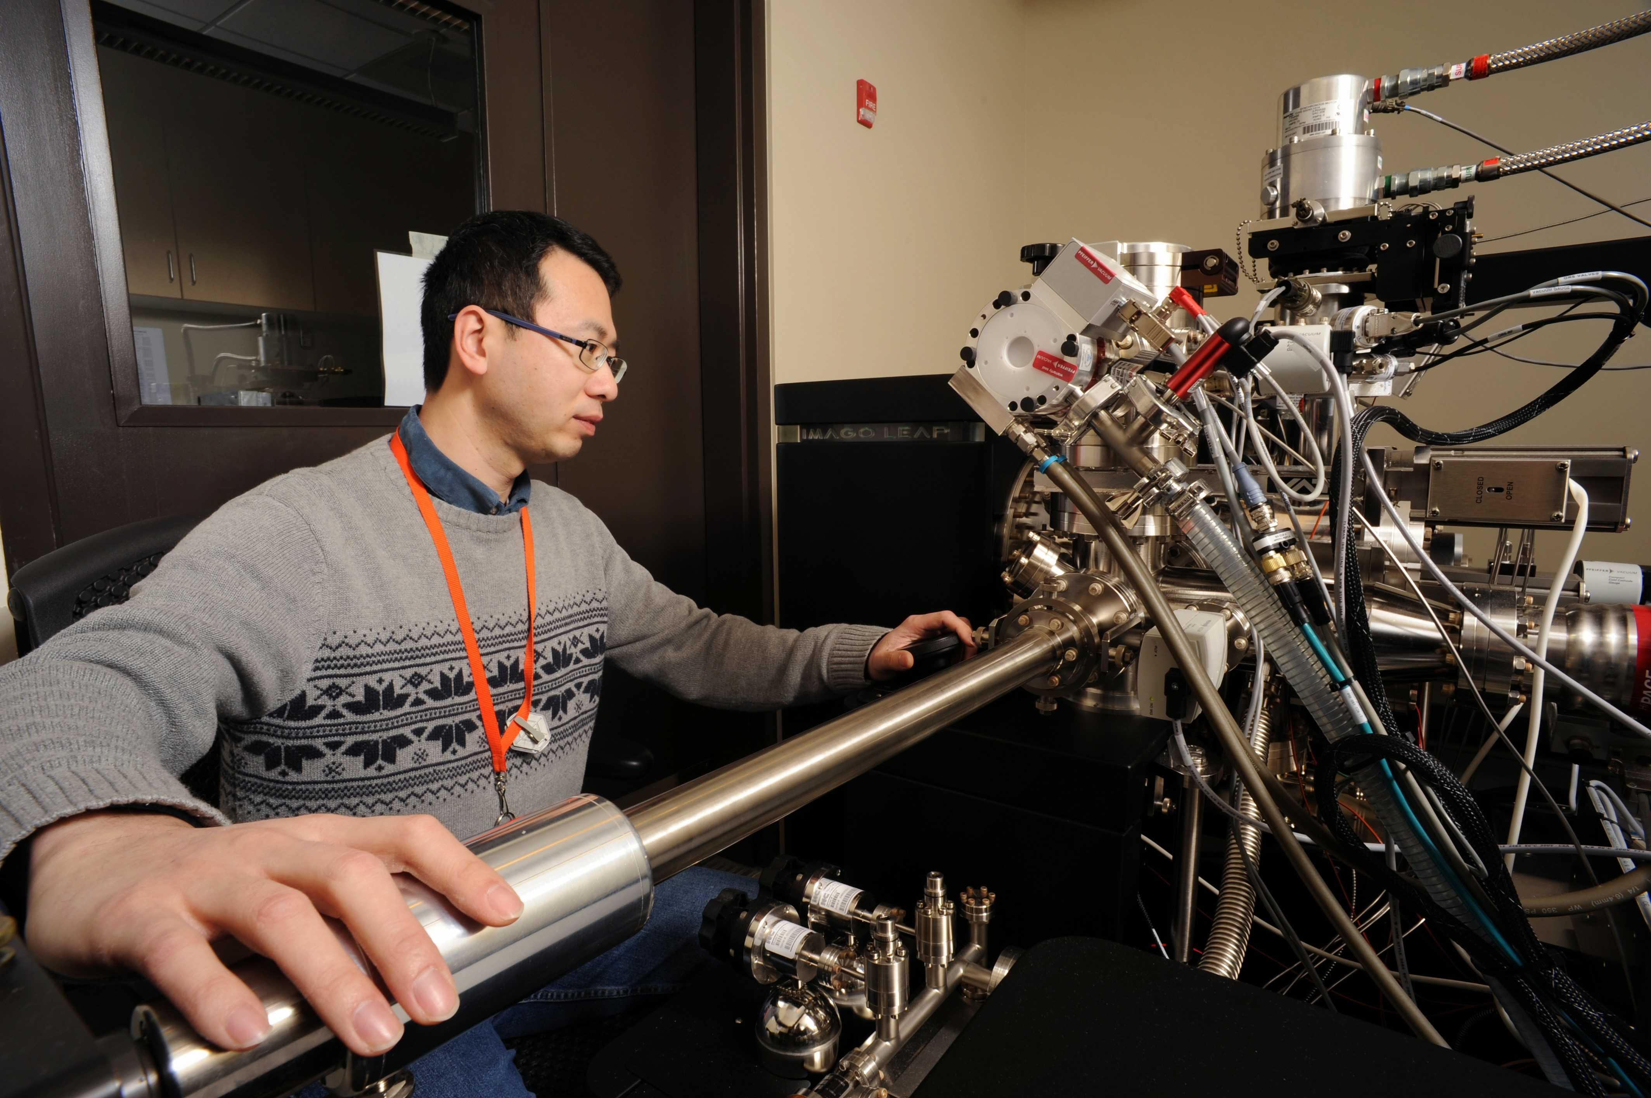
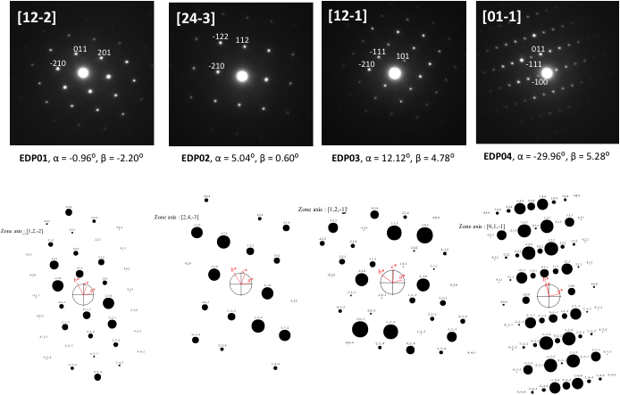
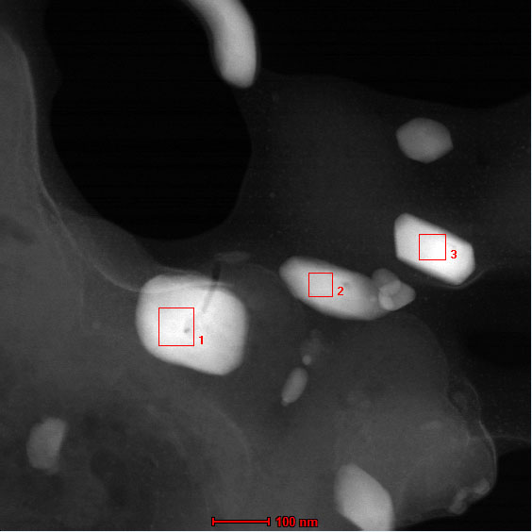
Cameca 4000X HR Local Electrode Atom Probe
Notes:
Two phases are identified within this volume, i.e., Fe oxide and C-/H- rich phase (polymer-like?). Pb atoms are also richer in C-/H- rich phase.

Slide 23
VIP Topic and Motivation
Cultural Studies + Materials Science Analyses
Greco-Roman Egypt + Nanoscale pigment analyses
Fayum mummy portraits + Materials for the color purple

Slide 24
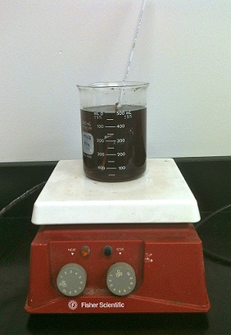
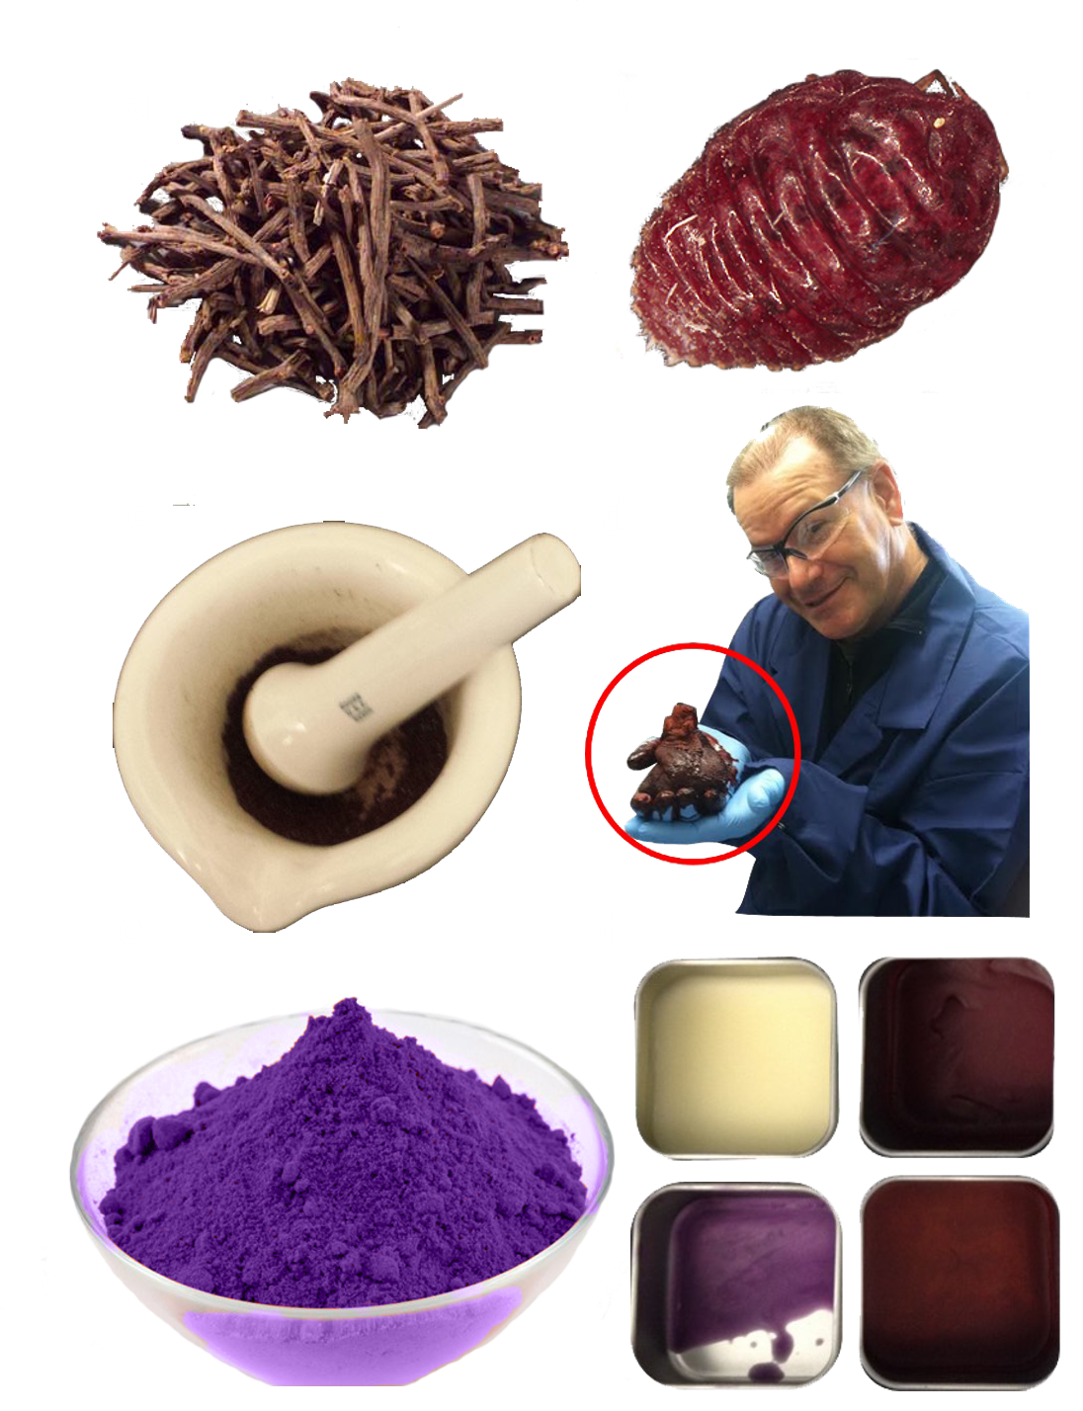
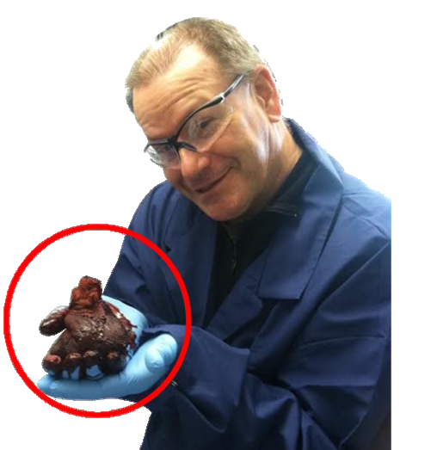
Methods
c

Slide 25
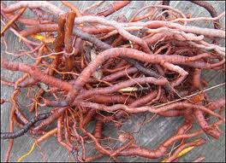
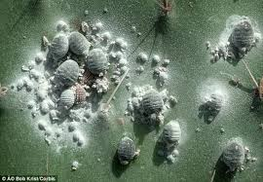
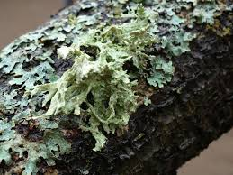
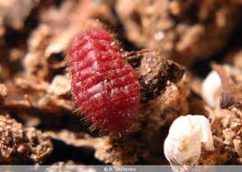
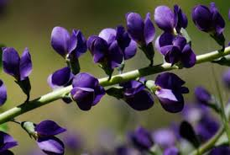
Types of Organic Pigments
Madder Root
Cochineal Insect
Lichen
Indigo
Kermes Insect

Slide 26
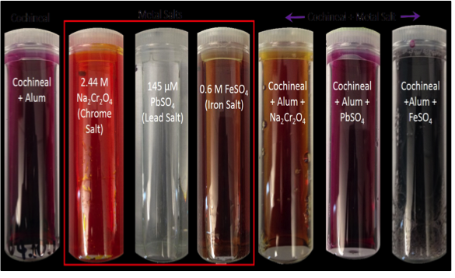
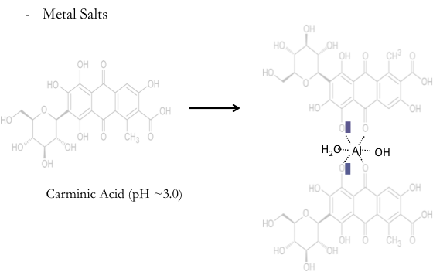
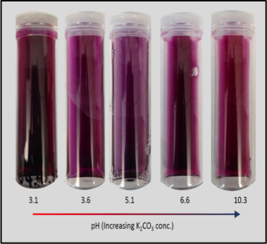
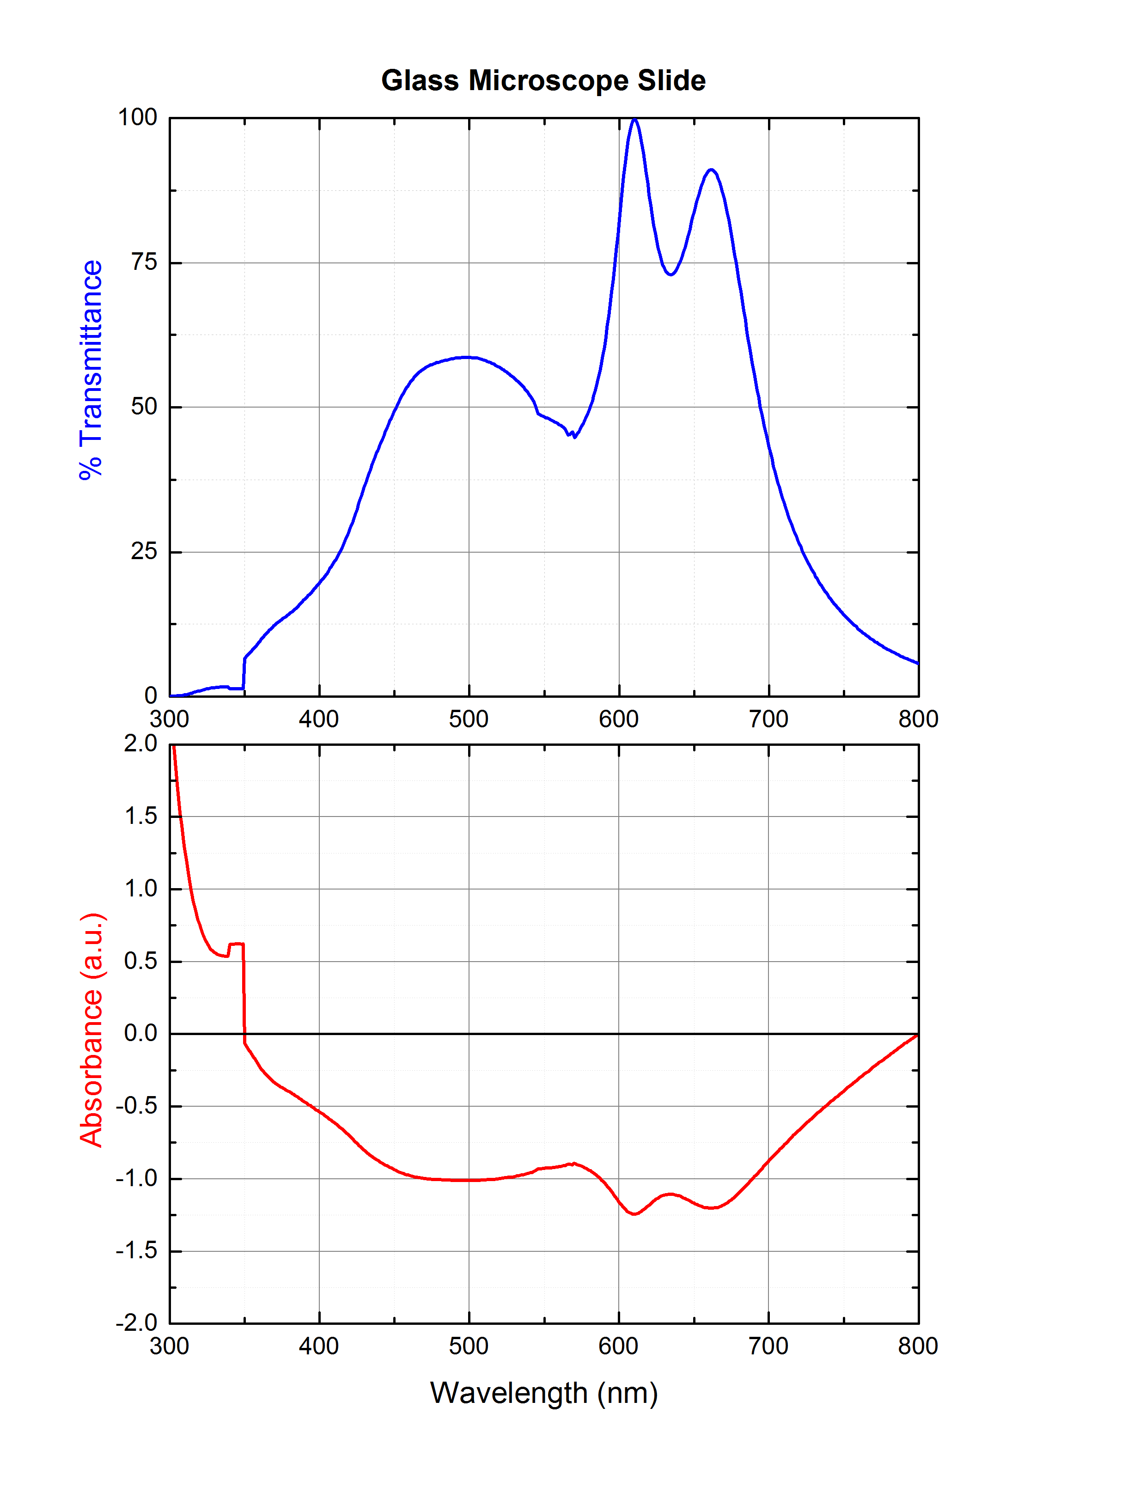
Color Shifting Techniques

Slide 27
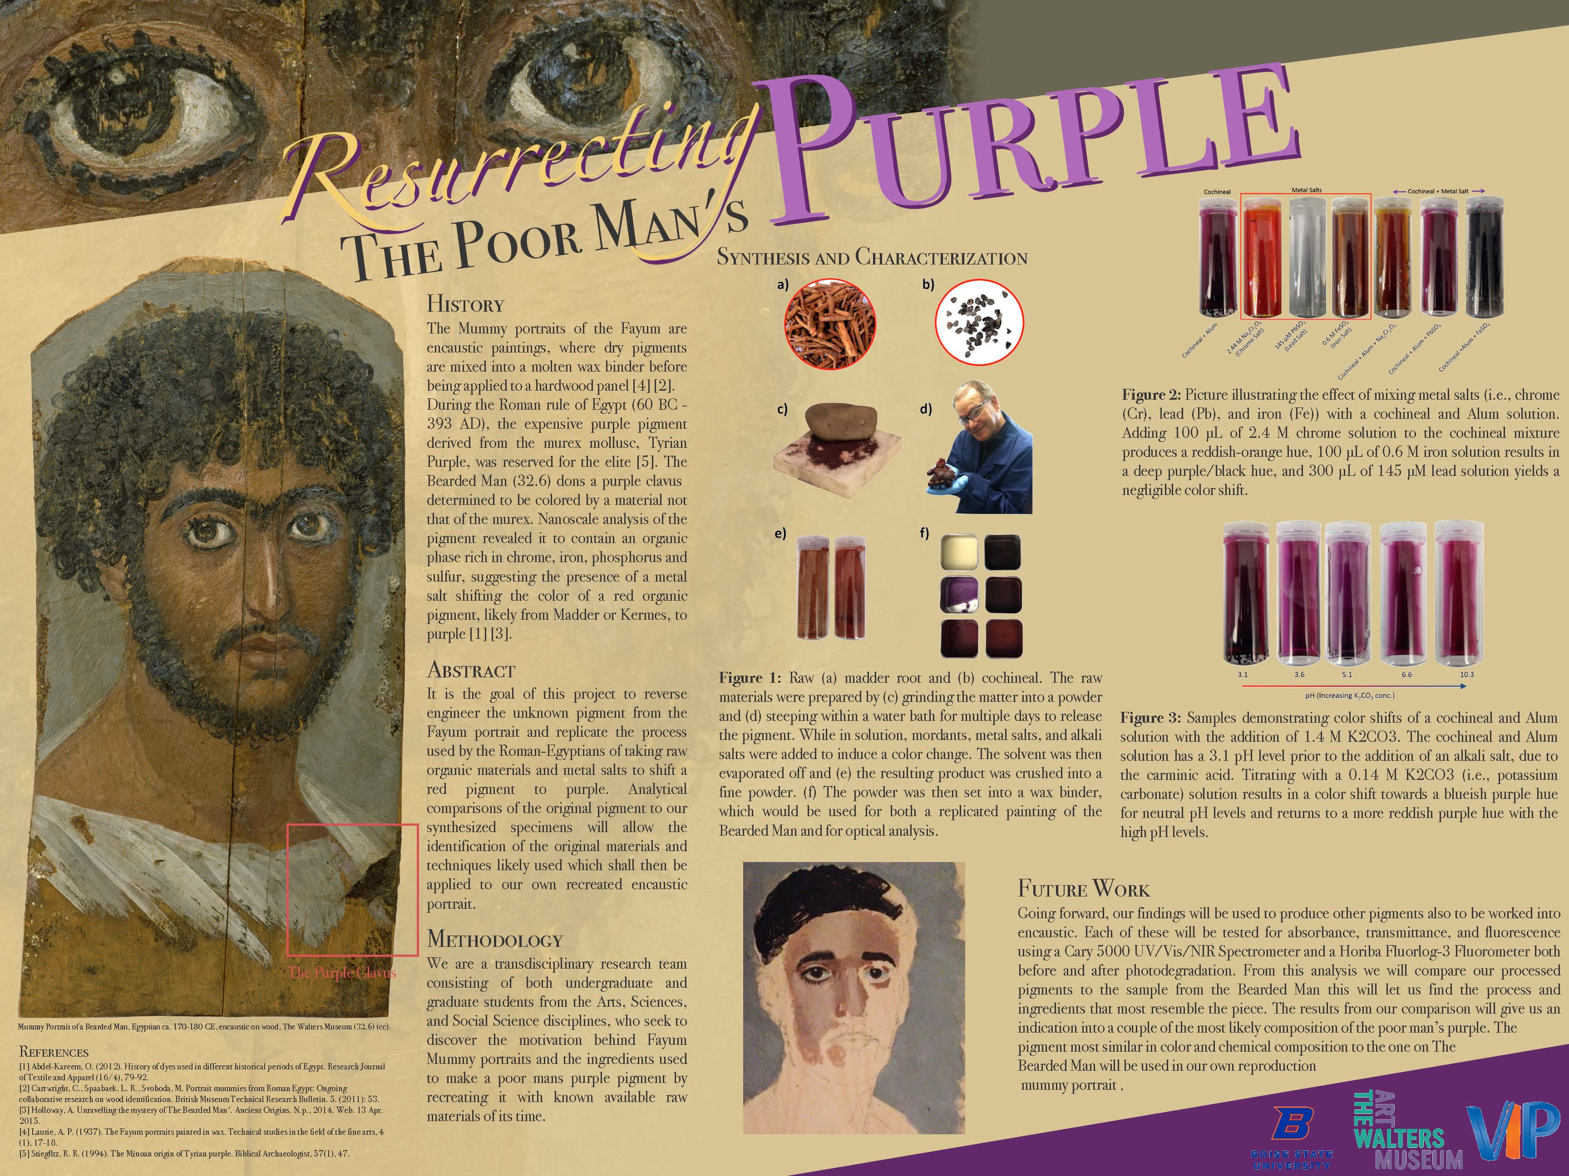

Slide 28
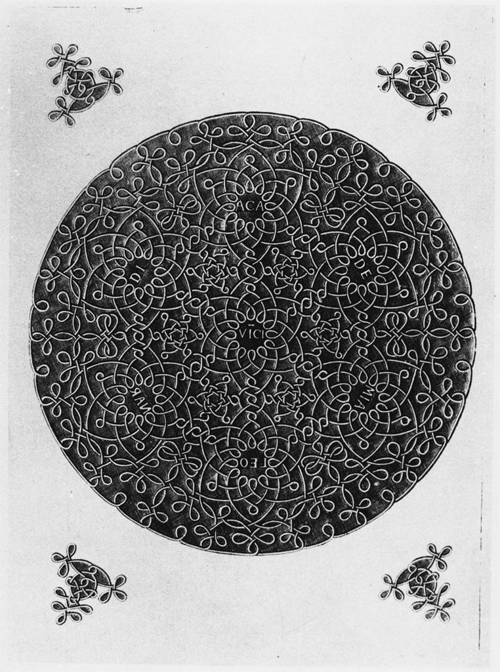
END
Notes:
Its not about the answers, so much as it is about the pursuit…

